Slide 1
G2P Connect/MOSIP Integration Paul Makin
9th March 2023

Slide 2
PI-21 Workstream Readout Summary
Workstream Name: | G2P Connect/MOSIP Integration
Roadmap Pillar: | Pillar 3, “Connect to Other Systems”
Lead: | Paul Makin
Workstream Objectives: | Demonstrate the ability to send money to the account of someone registered with a MOSIP identity, without knowing any details of their account. ”Send money to ME, not my account”.
Progress Against Objectives: | Agreements with MOSIP in place, high level design work complete. Need to develop the necessary ALS/oracle extensions, then go to PoC.
Issues: | A friendly way of identifying someone with a MOSIP registration
(If not completed) Plans for Next PI: | ALS/Oracle development, PoC.

Slide 3








Mojaloop and the DPG Community: G2P Connect

Slide 4
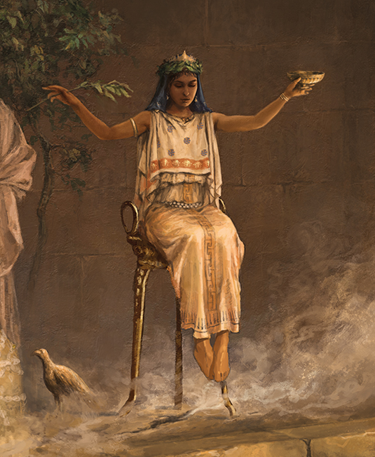
Direct Integrations
(The Other DPGs)
DFSPs
An Oracle

Slide 5
The Oracle
We COULD use it in the conventional manner, routing via MSISDNs etc
But Mojaloop Oracle technology is very flexible, so we can take advantage of that and even expand its functionality
What if we tried to use it to route to PEOPLE, rather than wallets or bank accounts?
MOSIP identifies people…and MOSIP is part of G2P Connect…so how about routing to MOSIP digital identities?
And do it in a way that makes MOSIP-based routing transparent to other DPGs

Slide 6
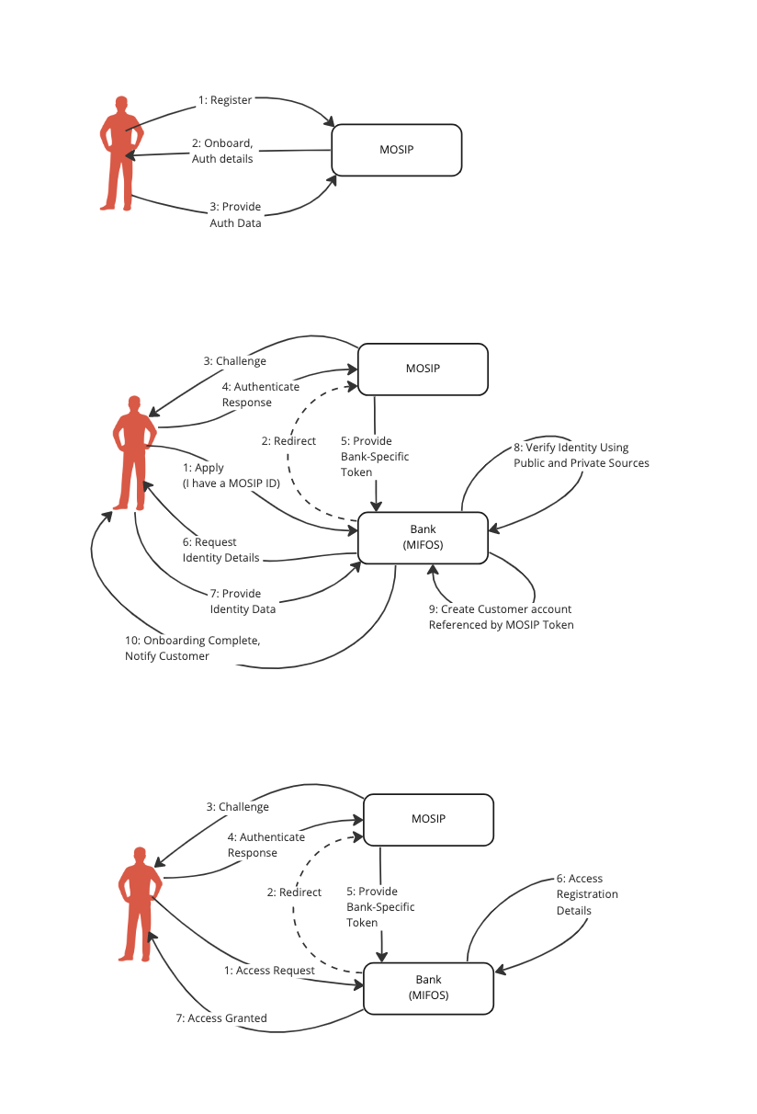
MOSIP is Privacy Preserving Background
A digital identity service that preserves privacy. Let’s see how that works.

Slide 7
MOSIP is Privacy Preserving Background
A digital identity service that preserves privacy. Let’s see how that works.

Slide 8
MOSIP is Privacy Preserving Background
A digital identity service that preserves privacy. Let’s see how that works.

Slide 9
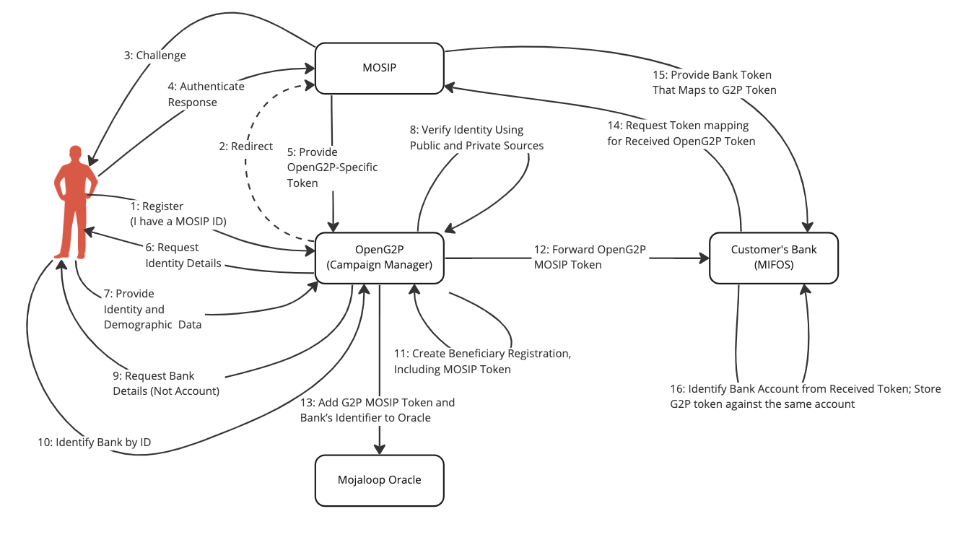
MOSIP Citizen Registering with OpenG2P OpenG2P and the Mojaloop Oracle

Slide 10
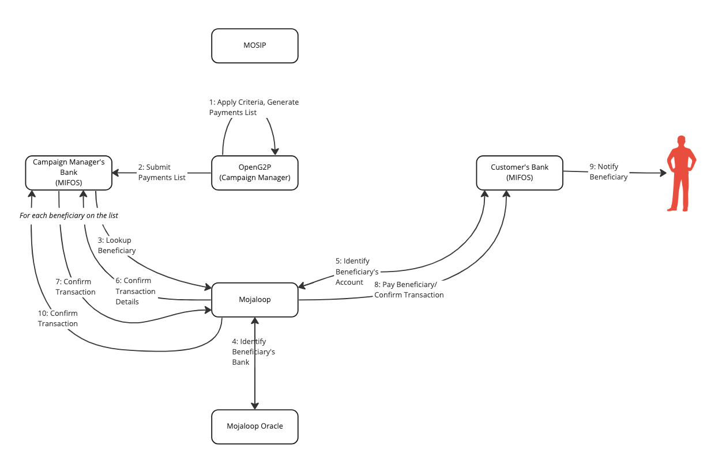
Beneficiary Receiving a Social Payment
This can be done by submitting a bulk payment list to Mojaloop

Slide 11
Status
Significant Progress
Mechanisms agreed between Mojaloop and MOSIP
Mifos/Mojaloop integration brought current
OpenG2P already experienced in Mojaloop BAU
Bulk payments is now G2P-ready
Outstanding Items
Agree how a MOSIP token may be represented
Next Steps
Oracle enhancements
PoC/Pilot

Slide 12
Thank you

